Slide 1

Project Presentation-II
Minimum Norm Attack on KNN classifier
Group No.: 11
Sonam Bharti (202117014)
Aditi Rajput (202117019)
Adversarial Machine Learning (IT566)

Slide 2
INTRODUCTION
Adversarial examples are ordinary samples that are slightly perturbed to fool machine learning models, and highlight the fragility of neural networks.
Recently, this has motivated research on classical kNN classifiers to study their robustness properties and to leverage kNN for providing interpretability and robustness to neural networks. kNN based models are not differentiable. So, Evaluating these models is very difficult. Most existing attacks rely on gradient descent and thus can’t be applied to kNN-based models.
We consider a complete white-box threat model for this project, meaning that the adversary has access to the training set, the value of k and the distance metric used in kNN, and all parameters of the neural networks.

Slide 3
Problem Statement
We study the robustness against adversarial examples of kNN classifiers and classifiers that combine kNN with neural networks.
The main difficulty lies in the fact that finding an optimal attack on kNN is intractable for typical datasets.
In this project, we propose a gradient-based attack on kNN and kNN-based defenses.
We demonstrate that our attack outperforms the old methods on all of the models we will test, with only a minimal increase in the computation time.

Slide 4
Datasets
We are using MNIST dataset for this project.
The MNIST database contains 60,000 training images and 10,000 testing images of small square 28×28 pixel grayscale images of handwritten single digits between 0 and 9.
Half of the training set and half of the test set were taken from NIST's training dataset, while the other half of the training set and the other half of the test set were taken from NIST's testing dataset.

Slide 5
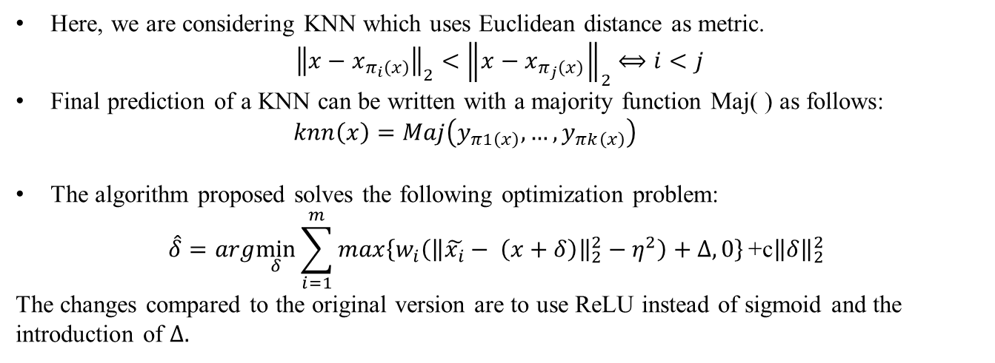
Approach
We denote pertubed version of $x$as$\hat{x}=x+δ$ where $x$∈ R^{d}.
The training set used by KNN and to train the neural network is $\left(X,Y\right)$ where
$X= \left\{x1, x2, …, xn\right\}$ and $Y = \left\{y1, y2, …, yn\right\}$
Here, we are considering KNN which uses Euclidean distance as metric.
$${\left\|x−x_{π_{i}\left(x\right)}\right\|}_{2}<{ \left\|x−x_{π_{j}\left(x\right)}\right\|}_{2} ⟺i<j$$
Final prediction of a KNN can be written with a majority function Maj( ) as follows:
$knn\left(x\right)=Maj\left(y_{π1\left(x\right)},…, y_{πk\left(x\right)}\right)$
The algorithm proposed solves the following optimization problem:
$$\hat{δ}=arg\min_{δ}{\sum_{i=1}^{m}{max\left\{w_{i}\left({\left\|\tilde{x_{i}}− \left(x+δ\right)\right\|}_{2}^{2}−η^{2}\right)+Δ,0\right\}}\text{+}\text{c}{\left\|δ\right\|}_{2}^{2} }$$
The changes compared to the original version are to use ReLU instead of sigmoid and the introduction of $Δ.$

Slide 6
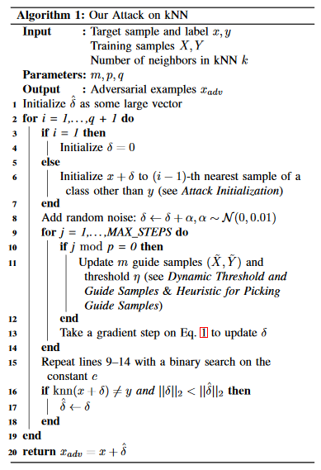

Slide 7
Deep kNN
$$\sum_{lεL}{\sum_{i=1}^{m}{max\left\{w_{i}\left(d_{l}{\left({\tilde{x}}_{i}, x+δ\right)}^{2} − η_{l}^{2}\right)+ Δ, 0\right\}}}+c{\left\|δ\right\|}_{2}^{2}$$
∑_𝑙𝜖𝐿▒∑_(𝑖=1)^𝑚▒𝑚𝑎𝑥{𝑤_𝑖 (𝑑_𝑙 (𝑥 ̃_𝑖, 𝑥+𝛿)^2 − 𝜂_𝑙^2 )+ Δ, 0} +𝑐‖𝛿‖_2^2
Single Layered Deep kNN
L is a set of layers used by the kNN and here L only contains the penultimate layer of NN.
Dubey et.al
Here kNN is applied on a linearly transformed space.
The attack on DkNN can be directly applied to single layered DkNN.
$d\left(x_{1},x_{2}\right)={\left\|A\left(φ\left(x_{1}\right)−μ\right)−A\left(φ\left(x_{2}\right)−μ\right)\right\|}_{2}$ where
𝑑(𝑥_1,𝑥_2 )=‖𝐴(𝜙(𝑥_1 )−𝜇)−𝐴(𝜙(𝑥_2 )−𝜇)‖_2 where
A is a PCA transformation matrix
$μ$ is the mean of $φ\left(x\right)$ across the training set.
𝜇 is the mean of 𝜙(𝑥) across the training set.
$φ\left(x\right)$ is a concatenation of average pooling of $f_{l}\left(x\right)$ for every layer l
𝜙(𝑥) is a concatenation of average pooling of 𝑓_𝑙 (𝑥) for every layer l

Slide 8
Experimental Results
In the algorithm used in this project, the parameters are set as follows: m=k+1,p=20 and q=3.
K | Attacks | Mean l₂-Norm | Approx. Running Time
1 | Yang et al. (Exact) Yang et al. (Approx.) Sitawarin & Wagner Ours | 2.4753 2.4753 3.4337 2.7475 | 30 hrs 2 hrs 1 mins 5 mins
3 | Yang et al. (Approx.) Sitawarin & Wagner Ours | 2.9857 3.9132 2.9671 | 11 hrs 1 mins 5 mins
5 | Yang et al. (Approx.) Sitawarin & Wagner Ours | 3.2473 3.9757 3.0913 | 44 hrs 1 mins 5 mins
Table: Comparison of Attacks on KNN

Slide 9
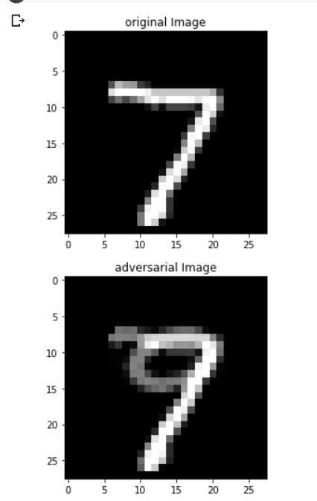
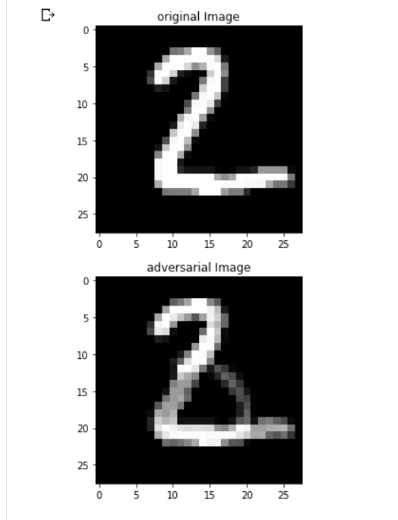
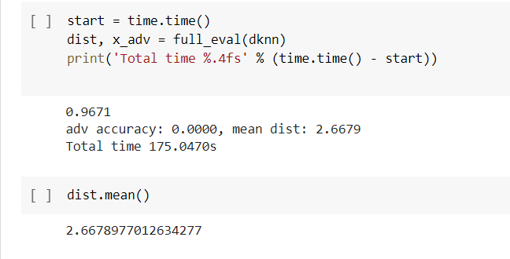
OUTPUTS

Slide 10
Conclusion
An attack on kNN and kNN-based classifiers was shown and it improves on prior
work.
Our attack can be used as a flexible and efficient method for evaluating the robustness of kNN
and kNN-based models on real-world datasets.

Slide 11
Suggestion for Improvement
We have only considered l₂ attacks as gradient-based approaches, which also generally do not work well for finding minimum-l∞-norm adversarial examples.
We have only discussed the robustness against an untargeted attack, but our method easily generalizes to targeted attacks. So we can improve our model to work effectively against targetted attacks.

Slide 12
References
[1] C. Sitawarin and D. Wagner, “Minimum-Norm Adversarial Examples on KNN and KNN-Based Models”, presented at 3rd Deep Learning and Security Workshop (41st IEEE Symposium on Security and Privacy) vol: abs/2003.06559, 2020
[2] C. Sitawarin and D. Wagner, “On the robustness of Deep K-nearest Neighbour”, Published at Deep Learning and Security Workshop 2019 (IEEE S&P) vol: abs/1903.08333, 2019.
[3] A. Dubey, L. van der Maaten, Z. Yalniz, Y. Li, and D. K. Mahajan, “Defense against adversarial images using web-scale nearest-neighbor search,” CoRR, vol. abs/1903.01612, 2019

